Slide 1


CITY ENGINEERING COLLEGE
DEPARTMENT OF COMPUTER SCIENCE AND ENGINEERING
INTERNSHIP PRESENTATION
ON
CREDIT CARD FRAUD DETECTION
By : Apeksha Bharadwaj H
(1CE17CS016)
Under the guidance of :
Mrs.Deepika R

Slide 2
ABSTRACT
It is vital that credit card companies are able to identify fraudulent credit card transactions so that customers are not charged for items that they did not purchase. Such problems can be tackled with Data Science and its importance, along with Machine Learning. This project intends to illustrate the modelling of a data set using machine learning with Credit Card Fraud Detection.
The Credit Card Fraud Detection Problem includes modelling past credit card transactions with the data of the ones that turned out to be fraud. This model is then used to recognize whether a new transaction is fraudulent or not. Our objective here is to detect 100% of the fraudulent transactions while minimizing the incorrect fraud classifications. Credit Card Fraud Detection is a typical sample of classification. In this process, we have focused on analysing and pre-processing data sets as well as the deployment of multiple anomaly detection algorithms such as Local Outlier Factor and Isolation Forest algorithm on the PCA transformed Credit Card Transaction data.

Slide 3
INTRODUCTION
Fraud detection involves monitoring the activities of populations of users in order to estimate, perceive or avoid objectionable behaviour, which consist of fraud, intrusion, and defaulting.
This is a very relevant problem that demands the attention of communities such as machine learning and data science where the solution to this problem can be automated.
These are not the only challenges in the implementation of a real-world fraud detection system, however. In real world examples, the massive stream of payment requests is quickly scanned by automatic tools that determine which transactions to authorize

Slide 4
COMPANY PROFILE
The Tech Fortune group was originally incepted in 2013 to focus only on EPC assignment of Infra and Real Estate Projects. Later the Company shifted its focus towards software development, Training ,BPO, Sourcing, Food Business, Health Care and Strategic Advisory Services. The Tech Fortune group Tech Fortune was born in 2013 with an objective to create a landmark initiative by a group of highly qualified technology oriented professionals in the software domain. A Software development Firm head quartered in Vijapur and operating for 5 years in with 3 offices across Karnataka. Since its inception in 2013, Tech fortune group has grown rapidly with the help of its valued Customers, professionals & Business Associates who have been continuously contributing and monitoring the Company’s business activities in the operations of Project Management, Education Consultancy, QMS and Six Sigma implementation and many other domain of expertise.
Tech Fortune Technologies, is an emerging technology organization in the fields of business process outsourcing, software development, end-to-end ERP solutions, Artificial Intelligence, Block-chain technology with a focus on providing customized solutions to the various business needs of a diverse global clientele.

Slide 5
TRAINING CONTENT
PANDAS
Introduction to Pandas
Pandas is a Python package providing fast, flexible, and expressive data structures designed to work with relational or labeled data both. It is a fundamental high-level building block for executing practical, real world data analysis in Python. Pandas is well suited for:
Tabular data with heterogeneously-typed columns, as in an SQL table or Excel spreadsheet
Ordered and unordered (not necessarily fixed-frequency) time series data.
Arbitrary matrix data (homogeneously typed or heterogeneous) with row and column Labels.
Any other form of observational / statistical data sets. The data actually need not be labeled at all to be placed into a pandas data structure

Slide 6
NUMPY
Numpy introduction
The NumPy package (read as NUMerical PYthon) provides access to a new data structure called arrays which allow efficient vector and matrix operations.
It also provides a number of linear algebra operations (such as solving of systems of linear equations, computation of Eigenvectors and Eigenvalues)
MATPLOTLIB
Matplotlib is the most popular and mature library for plotting data using Python. It has all of the functionality you would expect, including the ability to control the formatting of plots and figures at a very fine level.

Slide 7
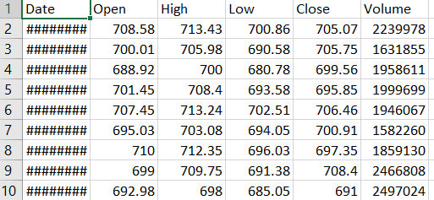
DATASET
In the over dataset, we've the dataset at that the Google stock opened from 1 February 26, 2016. we are going to attempt to anticipate the incentive at that,the stock will open on bissextile day, 2016. we'll be utilizing sk-learn, csv, NumPy and matplotlib bundles to actualize and picture direct relapse toward the mean. The Table describes the sample dataset:

Slide 8
METHODOLOGY
The approach that this paper proposes, uses the latest machine learning algorithms to detect anomalous activities, called outliers.
First of all, we obtained our dataset from Kaggle, a data analysis website which provides datasets. Inside this dataset, there are 31 columns out of which 28 are named as v1-v28 to protect sensitive data.
The other columns represent Time, Amount and Class. Time shows the time gap between the first transaction and the following one. Amount is the amount of money transacted. Class 0 represents a valid transaction and 1 represents a fraudulent one.

Slide 9

IMPLEMENTATION
The below fig shows the necessary libraries such as numpy, pandas, matplotlib are imported. Pandas is a python package designed to work with relational and labelled data.The key features of
Pandas include easy handling of missing data, it is built on top of NumPy,it has the property of flexibly reshaping and pivoting of datasets.
NumPy is a python library that provides support for multidimensional arrays,vector and matrices operations and linear algebra operations.
Matplotlib is a library for plotting data, has ability to control the formatting of plots and figures at fine level. It can create plots, histograms, scatterplots, barcharts, error charts etc.

Slide 10
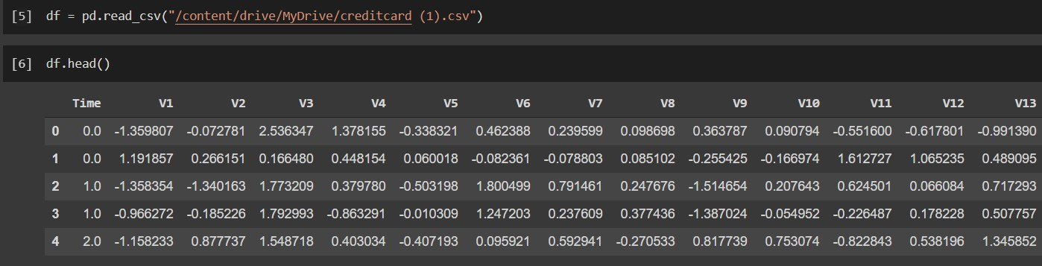
The below shows the dataset in the form of comma seperated file is imported using the read_csv command is imported. The head() method is is a pandas method used to return the top5 rows of the data frame by default

Slide 11
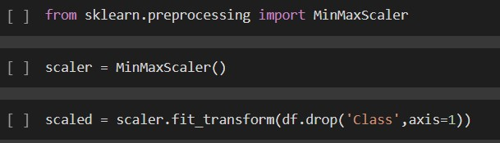
Scikit-learn is a library in python that provides many unsupervised and supervised learning algorithms. It’s built upon some of the technology you might already be familiar with,like Numpy,pandas,and Matplotlib. The below figure shows Import RandomForestClassifier from Scikit-learn library
The below Fig shows MinMaxScaler that transforms features by scaling each feature to a given range.

Slide 12

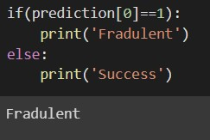
The accuracy obtained is 99.95% which is very high and this signifies that the model is very accurate and reliable.
Fig shows a user input is given to the model to predict if the transaction is fraudulent or not.
Fig 3.12 show the model predicting the right output for the user inputs

Slide 13
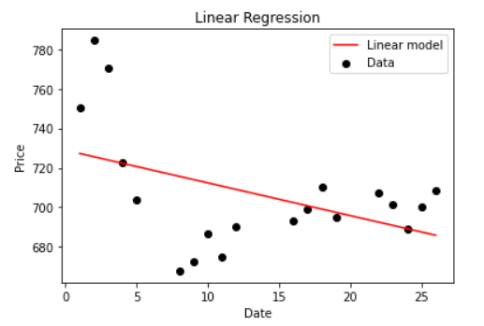
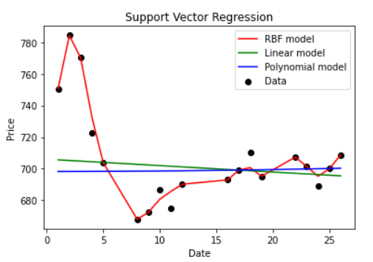
SNAPSHOTS

Slide 14
CONCLUSION
Credit card fraud is without a doubt an act of criminal dishonesty. This article has listed out the most common methods of fraud along with their detection methods and reviewed recent findings in this field.
This paper has also explained in detail, how machine learning can be applied to get better results in fraud detection along with the algorithm, pseudocode, explanation its implementation and experimentation results.
While the algorithm does reach over 99.95% accuracy, its precision remains only at 28% when a tenth of the data set is taken into consideration. However, when the entire dataset is fed into the algorithm, the precision rises to 33%.

Slide 15
FUTURE ENHANCEMENTS
This model can further be improved with the addition of more algorithms into it.
More room for improvement can be found in the dataset. As demonstrated before, the precision of the algorithms increases when the size of dataset is increased.
Online click fraud is the act of clicking on advertisements without a specific interest on the product.
Host it on a server, to take realtime feedback for future improvements.

Slide 16
REFERENCES
WEBSITES REFERRED
[1] www.geeksforgeeks.com
[2] www.w3schools.com
[3] www.stackoverflow.com

Slide 17
THANK YOU

